Slide 1

Text Analysis -Transformers
Most of the material has been taken from
Jurafsky & J. H. Martin: Speech and Language Processing, Pearson International 3ed draft https://web.stanford.edu/~jurafsky/slp3/
Jay Alammar, Maarten Grootendorst: Hands-On Large Language Models Published by O'Reilly Media, Inc.
Francesco Guerra
francesco.guerra@unimore.it
Big Data Analysis

Slide 2
Text Classification

Slide 3
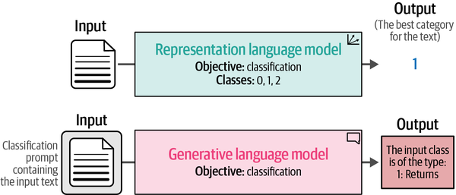
Text Classification
The goal of the task is to train a model to assign a label or class to some input text.
  Classifying text is used across for sentiment analysis, intent detection, extracting entities, detecting language ...
Two base techniques:

Slide 4
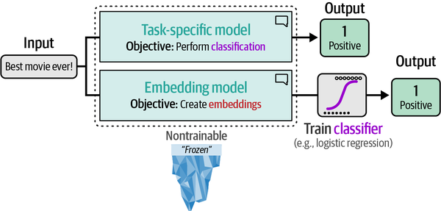
Text Classification with Representation Models
Two techniques:
  using a task-specific model or an embedding model

Slide 5
Model Selection
Choosing the right models is not as straightforward
  over 60,000 models on the Hugging Face Hub for text classification and more than 8,000 models that generate embeddings in 2025.
  it’s crucial to select a model that fits your use case and consider its language compatibility, the underlying architecture, size, and performance.
BERT (or one of its variations) are a popular choice for creating task-specific and embedding models. https://huggingface.co/models
    BERT base model (uncased)
    RoBERTa base model
    DistilBERT base model (uncased)
    DeBERTa base model
    bert-tiny
    ALBERT base v2

Slide 6
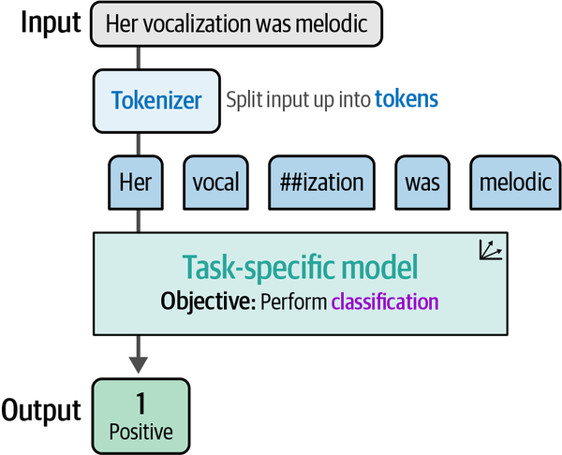
Using a Task-Specific Model

Slide 7
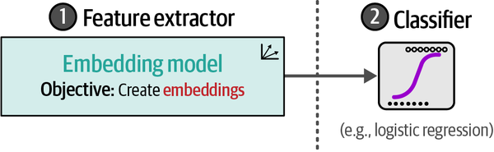
Classification Tasks That Leverage Embeddings
Typically a two step approach is used:
  an embedding model for generating features.
  a usual classifier fed with the features.
  Issue: generating embeddings of sentences

Slide 8
But… How Do We Generate Sentence Embeddings?
The most intuitive approach:
  Use BERT as an encoder to extract embeddings
Two common strategies:
  Use the [CLS] token
  Average all token embeddings
This gives us a vector per sentence usable in the 2-step pipeline.

Slide 9
Limits of BERT Embeddings
BERT was not designed for independent sentence embeddings.
  [CLS] and average pooling do not capture sentence-level semantics
  They often perform worse than simple GloVe averages
Embeddings are not positioned in vector space according to semantic similarity.
✔ Good for classification when trained jointly
❌ Poor when sentences are encoded independently.

Slide 10
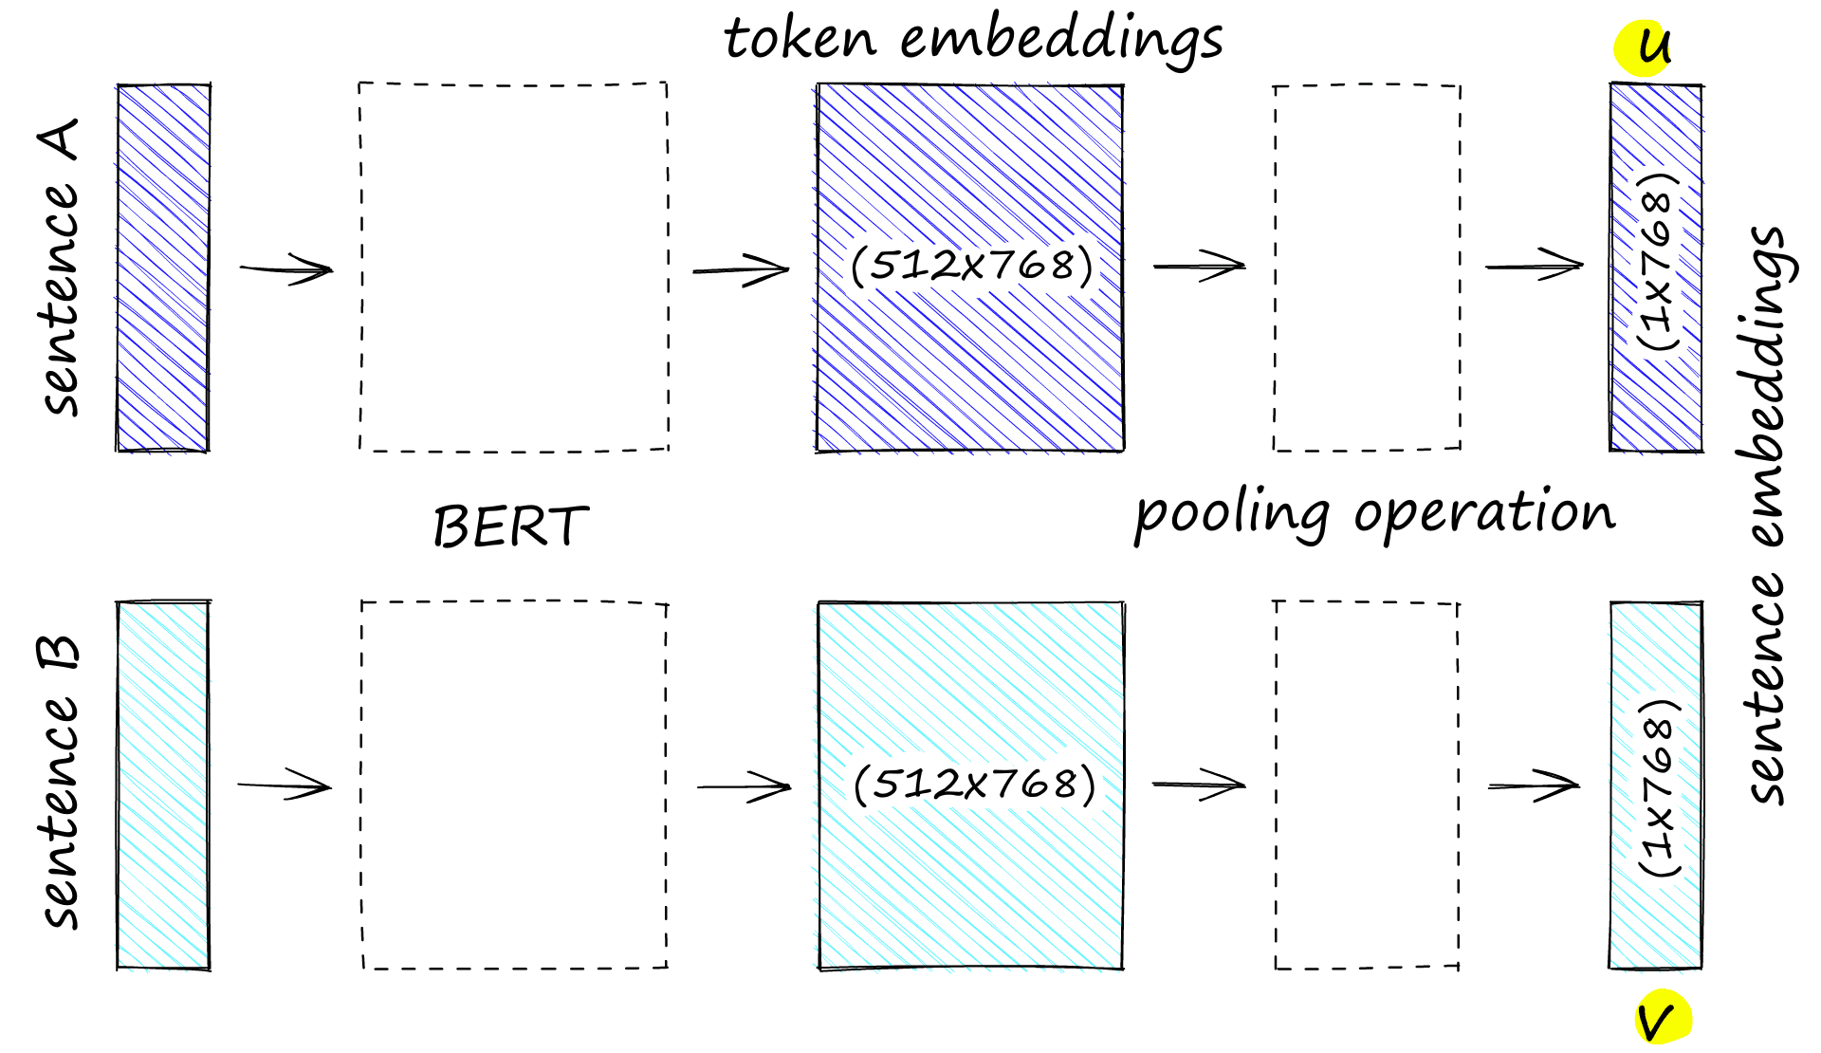
Sentence-BERT: Sentence embeddings using Siamese BERT-networks.(EMNLP 2019)
https://www.pinecone.io/learn/series/nlp/sentence-embeddings/#Sentence-Transformers

Slide 11
Sentence-BERT: Pre-training
Objective:
  Fine-tune Siamese BERT using softmax-loss.
  Datasets: SNLI (570K pairs) and MNLI (430K pairs).
Dataset labels:
  0 — entailment: premise implies hypothesis.
  1 — neutral: premise and hypothesis not necessarily related.
  2 — contradiction: premise and hypothesis contradict each other.
Procedure:
  Feed sentence A (premise) into BERT A and sentence B (hypothesis) into BERT B.
  Siamese BERT produces pooled sentence embeddings.
Pooling methods:
  Mean pooling (best performance for NLI and STS benchmark).
    Max pooling
    [CLS] pooling

Slide 12
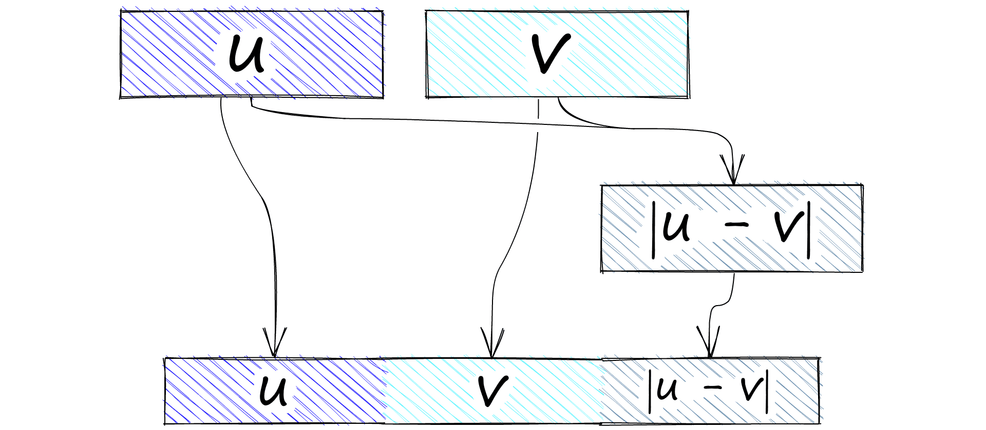
Sentence-BERT: Pre-training
There are now two sentence embeddings: embeddings A u and embeddings B v.
There are many concatenation approaches that we can test: highest performing is
(u, v, |u-v|).

Slide 13
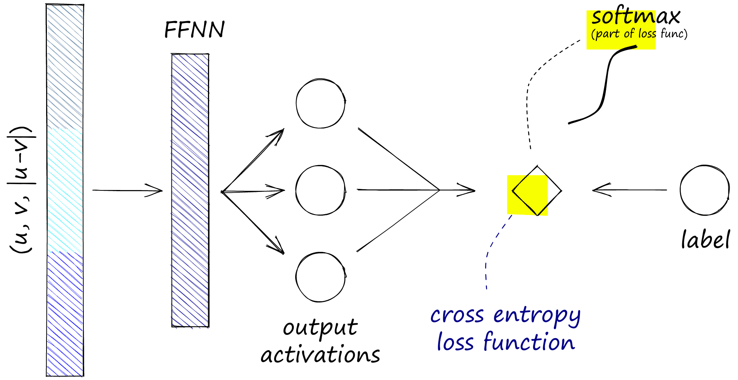
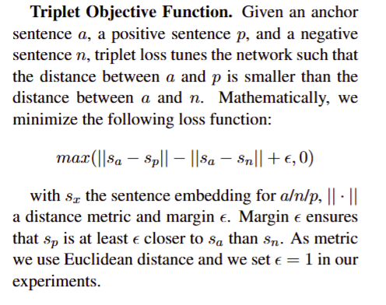
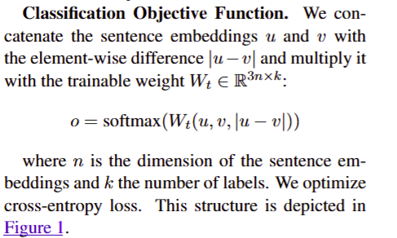
Sentence-BERT: Pre-training

Slide 14
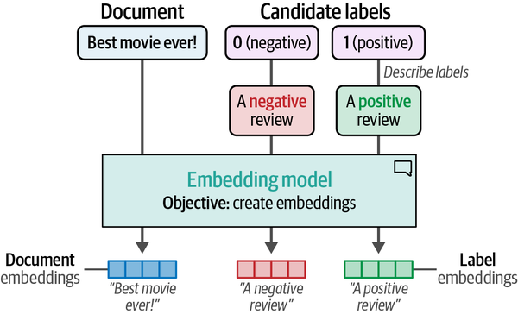
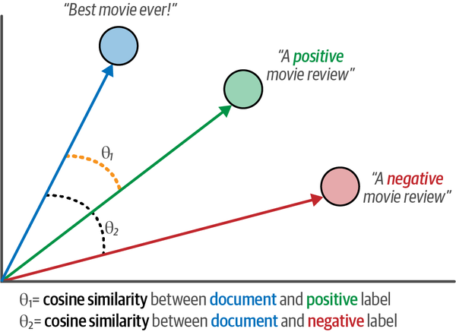
Zero-shot classification
Zero-shot classification attempts to predict the labels of input text even though it was not trained on them
  we can describe our labels based on what they should represent.
    a negative label can be described as “This is a negative movie review.”
  To assign labels to documents, we can apply cosine similarity to the document label pairs.

Slide 15
Text Classification with Generative Models
Prompt engineering: iteratively improving your prompt to get your preferred output.
  T5
  GPT

Slide 16
Text Clustering

Slide 17
Text Clustering
Text clustering aims to group similar texts based on their semantic content, meaning, and relationships, for
  facilitating efficient categorization of large volumes of unstructured text
  for quick exploratory data analysis.
A possible pipeline:
  Convert the input documents to embeddings with an embedding model.
  Reduce the dimensionality of embeddings with a dimensionality reduction model.
  Find groups of semantically similar documents with a cluster model.

Slide 18
Dimensionality Reduction
Transforming high-dimensional features into a lower-dimensional space preserving the most representative information.
  PCA (Principal Component Analysis): Linearly projects data onto axes of maximum variance; assumes global linear structure.
  T-SNE (t-Distributed Stochastic Neighbor Embedding): A nonlinear technique that preserves local similarities.
  UMAP (Uniform Manifold Approximation and Projection): A learning technique that preserves both local and some global structures.
  Autoencoder: Learns a nonlinear compressed representation through a neural network.

Slide 19
T-SNE key intuition
Mapping high-dimensional data points into a two- or three-dimensional data, preserving the local relationships between points.
  It achieves this by measuring the similarity between points in the high-dimensional space and representing this similarity as probabilities.
  It constructs a similar probability distribution in the lower-dimensional space and minimizes the difference between distributions using gradient descent.
Preserving local relationships between points
  “Preserving the local relationships between points” refers to maintaining the relative distances and similarities between neighboring data points when they are mapped from a high-dimensional space to a lower-dimensional space.
  Points that are close in high-dimensional space should remain close in low-dimensional space

Slide 20
Why Not Work Directly with Distances?
Compute the distance between points is not reliable in higher dimensions due to the “curse of dimensionality.”
  In high-dimensional spaces, all distances become similar
  Difference between nearest and farthest neighbors shrinks
  Distance rankings become unstable and noisy
Example Intuition
  In 2D: distances vary a lot → meaningful neighborhoods
  In 100D: distances concentrate around the mean
  Raw distances lose discriminative power

Slide 21
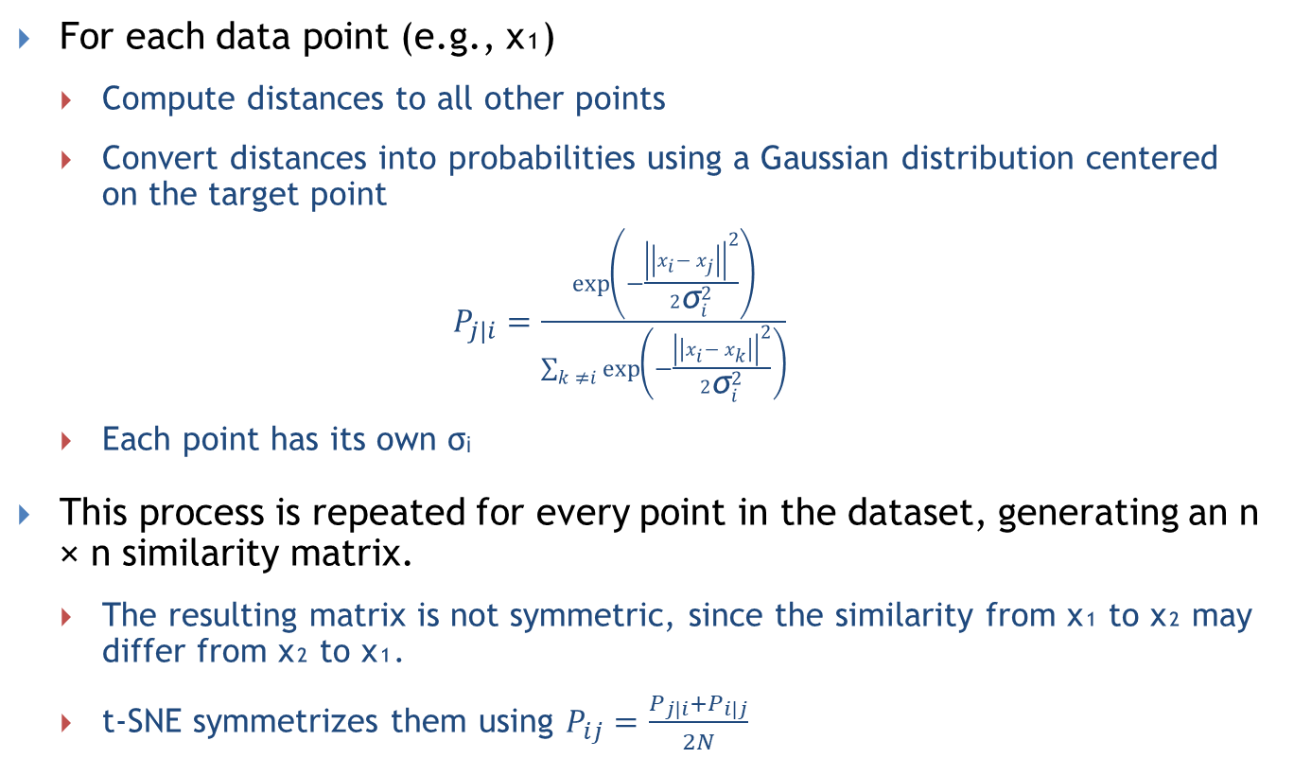
Step 1: Similarities in High Dimensions
Compute distances to all other points
For each data point (e.g., x₁)
  Compute distances to all other points
  Convert distances into probabilities using a Gaussian distribution centered on the target point
  $P_{j|i}=\frac{\exp\left(−\frac{{\left|\left|x_{i}− x_{j}\right|\right|}^{2}}{2{\text{σ}}_{i}^{2}}\right)}{\sum_{k ≠i}{\exp\left(−\frac{{\left|\left|x_{i}− x_{k}\right|\right|}^{2}}{2{\text{σ}}_{i}^{2}}\right)}}$
  Each point has its own σᵢ
This process is repeated for every point in the dataset, generating an n × n similarity matrix.
  The resulting matrix is not symmetric, since the similarity from x₁ to x₂ may differ from x₂ to x₁.
  t-SNE symmetrizes them using $P_{ij}=\frac{P_{j|i}+P_{i|j}}{2N}$

Slide 22
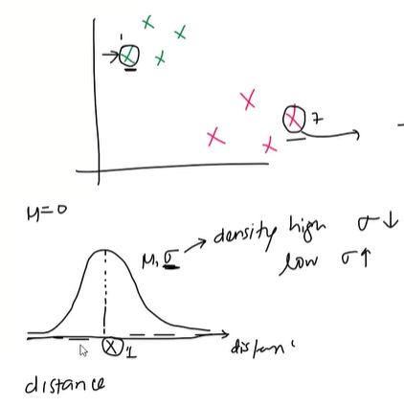
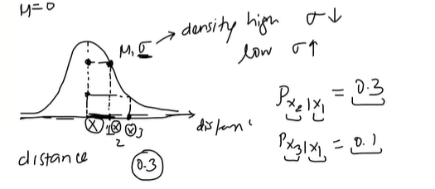
T-SNE in a nutshell

Slide 23
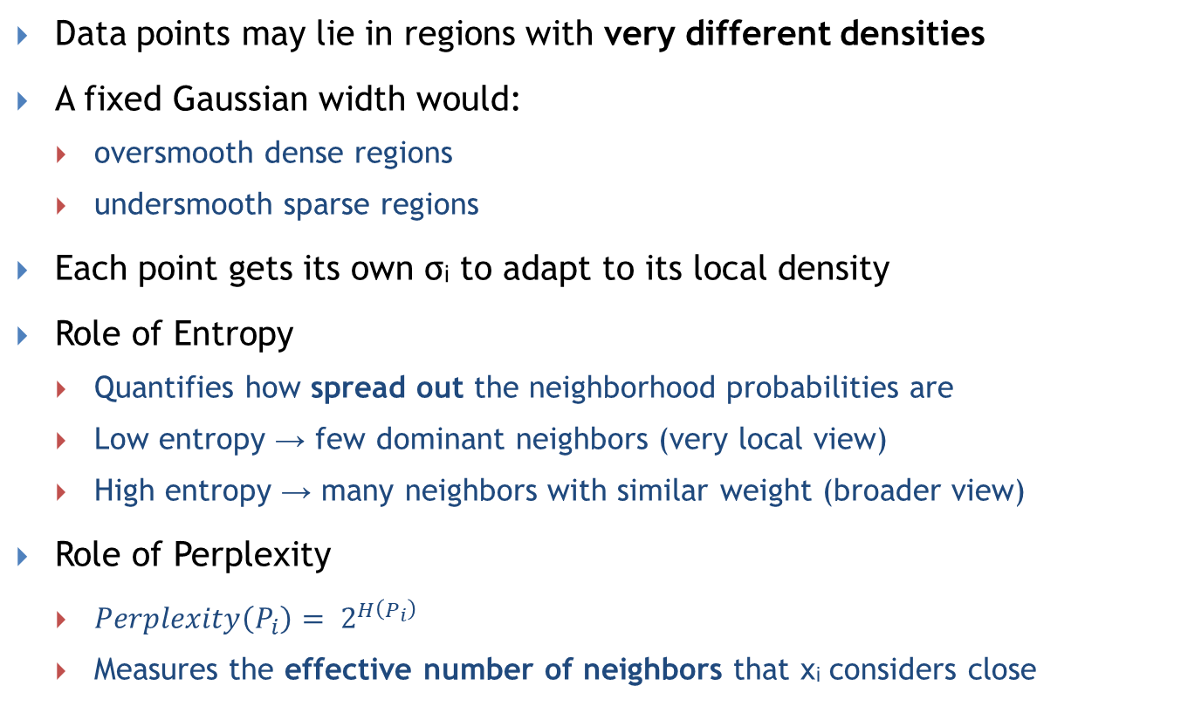
Choosing Sigma (σᵢ): Density Normalization via Entropy and Perplexity
Compute distances to all other points
Data points may lie in regions with very different densities
A fixed Gaussian width would:
  oversmooth dense regions
  undersmooth sparse regions
Each point gets its own σᵢ to adapt to its local density
Role of Entropy
  Quantifies how spread out the neighborhood probabilities are
  Low entropy → few dominant neighbors (very local view)
  High entropy → many neighbors with similar weight (broader view)
Role of Perplexity
  $Perplexity\left(P_{i}\right)= 2^{H\left(P_{i}\right)}$
  Measures the effective number of neighbors that xᵢ considers close

Slide 24
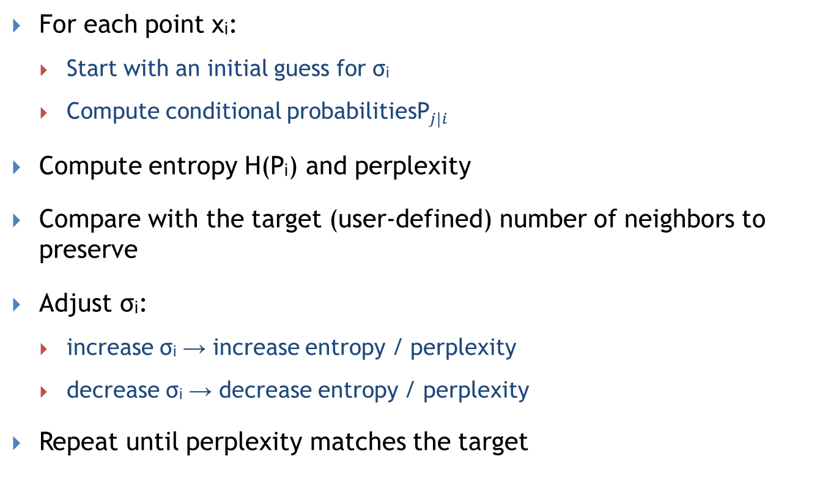
How σᵢ Is Computed (Binary Search)
Compute distances to all other points
For each point xᵢ:
  Start with an initial guess for σᵢ
  Compute conditional probabilities${\text{P}}_{j|i}$
Compute entropy H(Pᵢ) and perplexity
Compare with the target (user-defined) number of neighbors to preserve
Adjust σᵢ:
  increase σᵢ → increase entropy / perplexity
  decrease σᵢ → decrease entropy / perplexity
Repeat until perplexity matches the target

Slide 25
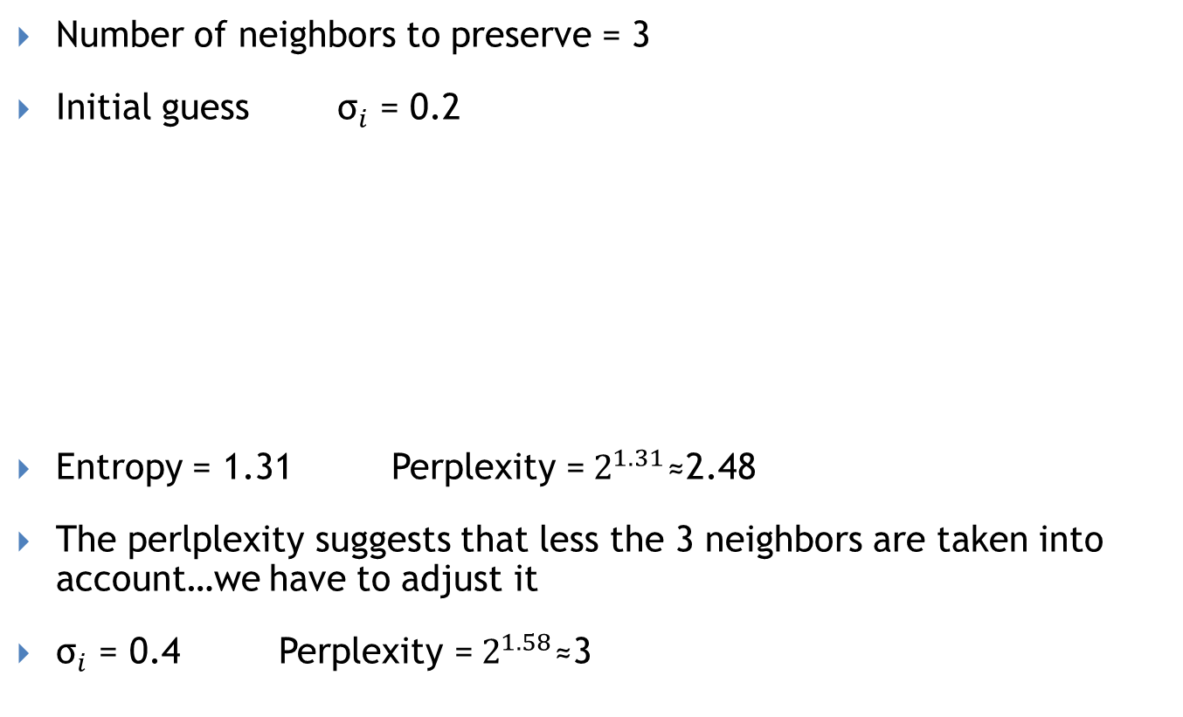
Example
Compute distances to all other points
Number of neighbors to preserve = 3
Initial guess ${\text{σ}}_{i}$ = 0.2
Entropy = 1.31 Perplexity =$2^{1.31}\text{≈2.48}$
The perlplexity suggests that less the 3 neighbors are taken into account…we have to adjust it
${\text{σ}}_{i}$ = 0.4 Perplexity =$2^{1.58}\text{≈}$3
Data point | Dist | Prob
A | 0.10 | 0.543
B | 0.20 | 0.374
C | 0.40 | 0.083
D | 0.80 | ~0
E | 1.60 | ~0

Slide 26
Step 2: Similarities in Low Dimensions
We now reduce the high-dimensional data into a lower-dimensional space, where data points are initially randomly placed along the x-axis.
In this lower-dimensional space, we recalculate the similarity scores for each point relative to all others.
This results in a second n × n similarity matrix, now based on low-dimensional distances.
At this point, we have two matrices:
  One representing similarity scores in the original high-dimensional space
  One representing similarity scores in the lower-dimensional space

Slide 27
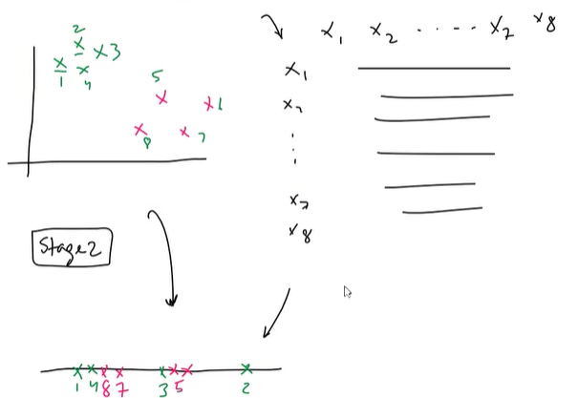
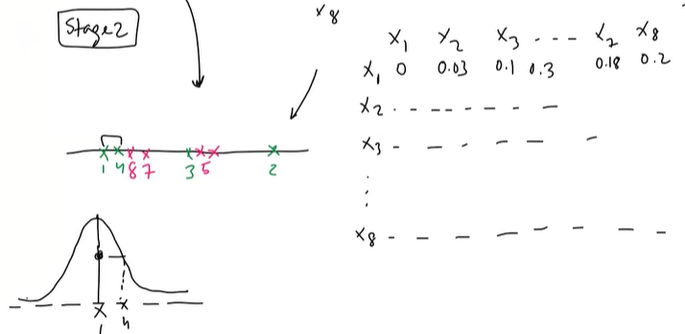
T-SNE in a nutshell

Slide 28
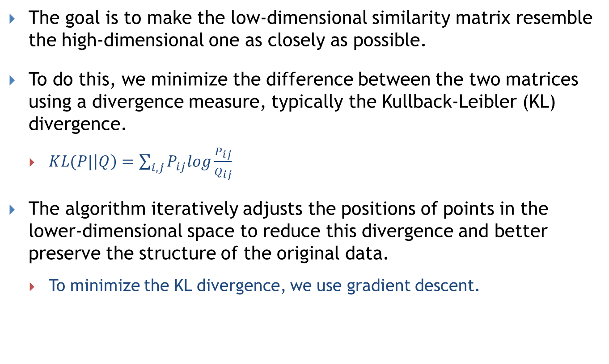
Optimization Objective
The goal is to make the low-dimensional similarity matrix resemble the high-dimensional one as closely as possible.
To do this, we minimize the difference between the two matrices using a divergence measure, typically the Kullback-Leibler (KL) divergence.
  $KL(P|\left|Q\right)=\sum_{i,j}{P_{ij}log\frac{P_{ij}}{Q_{ij}}}$
The algorithm iteratively adjusts the positions of points in the lower-dimensional space to reduce this divergence and better preserve the structure of the original data.
  To minimize the KL divergence, we use gradient descent.

Slide 29
T-SNE configuration
Perplexity: Measures the effective number of neighbors for each point. (5-50)
  Balances local vs. global structure: Low perplexity → focus on local details High perplexity → captures global structure
Learning Rate: Controls the step size during optimization. (10-100)
  Too high → algorithm may oscillate or miss global minimum.
  Too low → slow convergence, may get stuck in local minima.
Number of Iterations: Defines how many times the algorithm updates the embedding. (1000)
  Too few → embedding may not converge.
  Too many → unnecessary computational cost.

Slide 30
UMAP in a nutshell
Preserves Local & Global Structure: Captures both fine-grained details and overall data shape.
Flexible Parameter Tuning: n_neighbors and min_dist control the locality-globality trade-off.
Faster than t-SNE.
High-level intuition
  learns a graph in high-dimensional space
  learns a similar graph in low-dimensional space
  Goal: make the two graphs as similar as possible

Slide 31
UMAP Parameters
n_neighbors
  Controls the size of the local neighborhood used to build the graph structure (typical: 5–50)
min_dist
  Sets the minimum distance between embedded points.
  Low (0.0–0.1): tight clusters
  Medium (0.2–0.4): balanced
  High (0.5+): spread-out structure
n_components
  Dimensionality of the target space (e.g., 2D or 3D).
Metric
  Distance function for computing neighbor similarity (e.g. euclidean, cosine, manhattan).

Slide 32
Step 1: Construct a k-Nearest Neighbor Graph
For each point xᵢ:
  find its k nearest neighbors (KNN)
k is controlled by the parameter n_neighbors
Interpretation:
  Small k → focus on very local structure
  Large k → incorporate more global structure

Slide 33
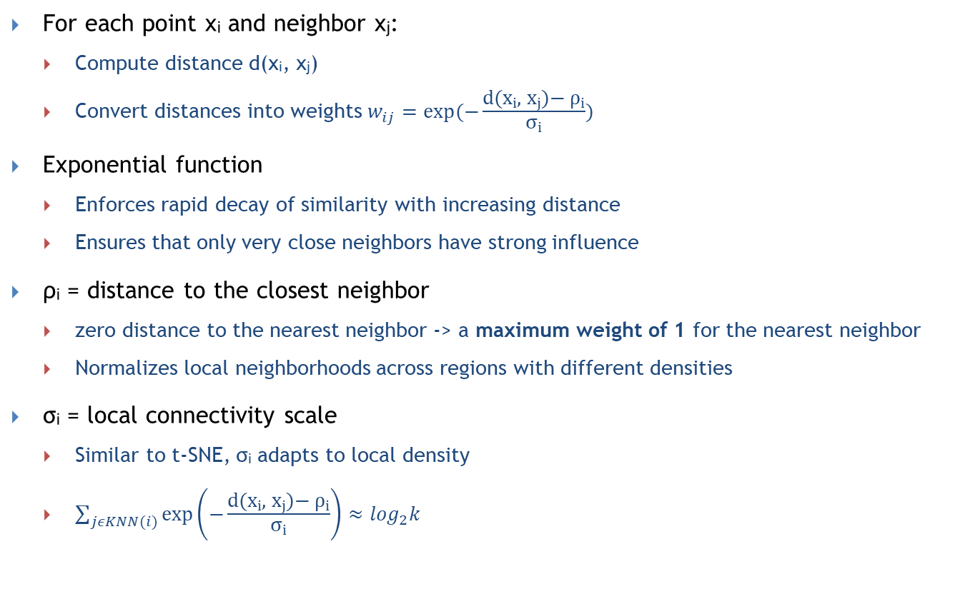
From Distances to Edge Weights
For each point xᵢ and neighbor xⱼ:
  Compute distance d(xᵢ, xⱼ)
  Convert distances into weights $w_{ij}=exp⁡(−\frac{\text{d}\text{(}\text{x}\text{ᵢ, }\text{x}\text{ⱼ)− }\text{ρ}\text{ᵢ}}{\text{σ}\text{ᵢ}})$
Exponential function
  Enforces rapid decay of similarity with increasing distance
  Ensures that only very close neighbors have strong influence
ρᵢ = distance to the closest neighbor
  zero distance to the nearest neighbor -> a maximum weight of 1 for the nearest neighbor
  Normalizes local neighborhoods across regions with different densities
σᵢ = local connectivity scale
  Similar to t-SNE, σᵢ adapts to local density
  $\sum_{jεKNN(i)}{\exp\left(−\frac{\text{d}\text{(}\text{x}\text{ᵢ, }\text{x}\text{ⱼ)− }\text{ρ}\text{ᵢ}}{\text{σ}\text{ᵢ}}\right)≈\log_{2}k }$

Slide 34

Symmetrization of the Graph
Neighborhood relations are asymmetric
UMAP symmetrizes edge weights using
  $w_{ij}^{sym}=w_{ij}+w_{ji}−w_{ij}∗w_{ji}$
Preserves strong mutual connections
Avoids shrinking weak one-sided links

Slide 35

Optimization Objective
Minimize cross-entropy between high-D and low-D graphs
  $CE=\sum_{i,j}{w_{ij}\log\left(q_{ij}\right)+(1−w_{ij})\log\left(1−q_{ij}\right))}$
Encourages:
  connected points to stay close
  unconnected points to stay apart

Slide 36
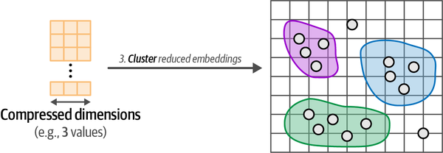
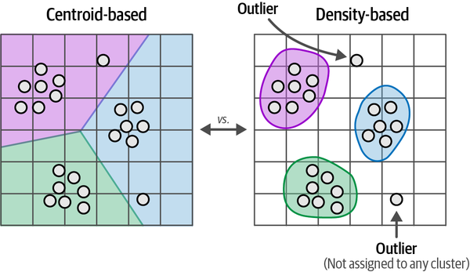
Cluster the Reduced Embeddings

Slide 37
HDBSCAN in a nutshell
HDBSCAN is a density-based clustering algorithm
  Clusters are defined as regions with many nearby points
  Sparse regions are considered separators or noise
Intuition:
  A cluster is a "crowded area"
  Noise lives in "empty space"
It automatically finds:
  clusters of varying density
  noise / outliers
Widely used after UMAP or t-SNE embeddings
No need to specify the number of clusters

Slide 38
HDBSCAN pipeline
Estimate local density (core distance)
Modify distances (mutual reachability)
Build MST
Construct hierarchy
Condense using minimum cluster size
Select clusters via stability

Slide 39
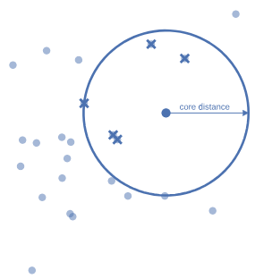
Step 1: Measuring Local Density
For each point xᵢ:
  find its k-th nearest neighbor (min_samples parameter)
The distance to this neighbor defines the core distance:
core_dist(xᵢ) = distance to the k-th nearest neighbor
Dense regions → small core distance
Sparse regions → large core distance

Slide 40
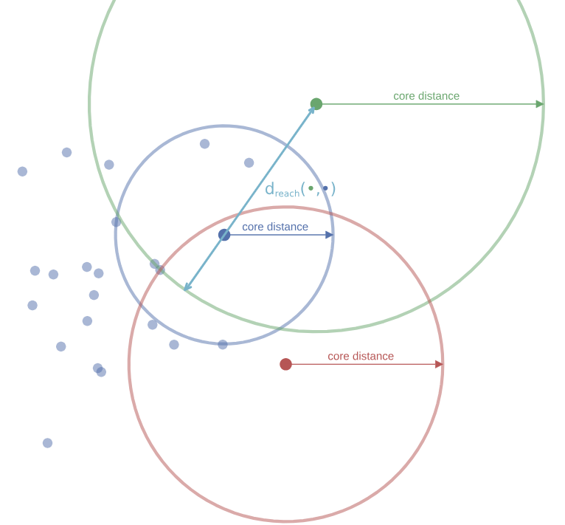
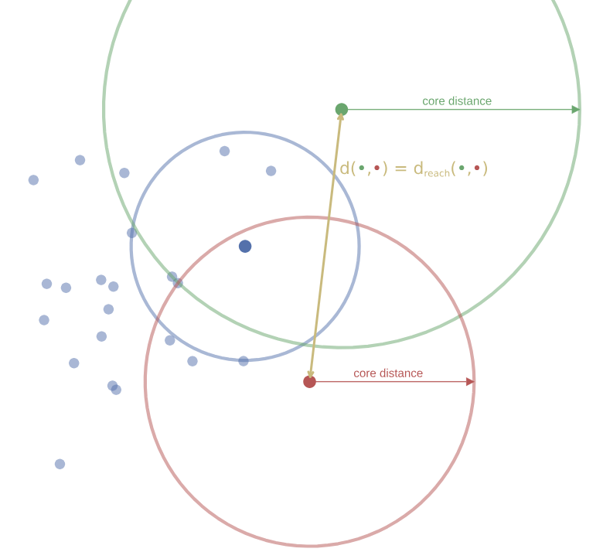
Mutual Reachability Distance
To compare two points xᵢ and xⱼ, HDBSCAN uses:
  mreach(xᵢ, xⱼ) = max(core_dist(xᵢ), core_dist(xⱼ), distance(xᵢ, xⱼ))
Intuition:
  Penalizes pairs involving sparse points
  Makes distances density-aware

Slide 41
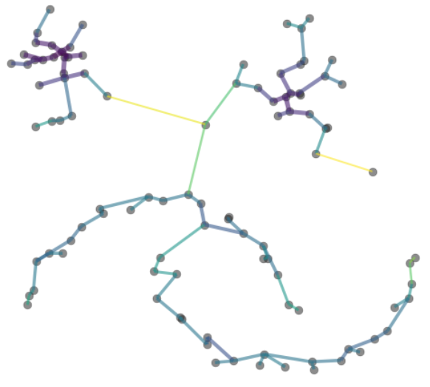
Build a Density-Aware Graph
Construct a graph where:
  nodes = data points
  edge weight = mutual reachability distance
Iteratively cutting a fully connected graph at different weight thresholds would be very expensive.
Compute a Minimum Spanning Tree (MST) of this graph
MST captures the essential density structure

Slide 42
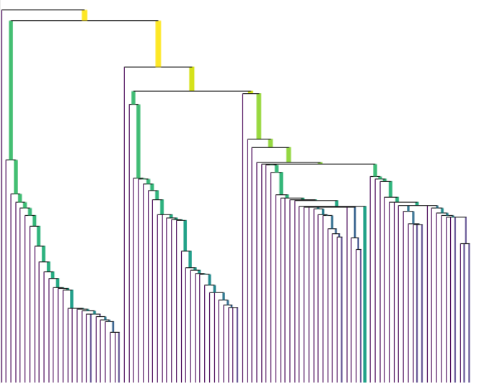
From MST to Hierarchical Clustering
Procedure:
  Sort MST edges by increasing weight
  Add edges one by one
  Connected components merge over time
This produces a single-linkage dendrogram:
  Leaves = individual points
  Merges happen at increasing distances

Slide 43
Why Distance-Based Cuts Are Not Enough
Suppose we cut the dendrogram at a fixed distance:
  Dense cluster → preserved
  Sparse cluster → destroyed
Or:
  Sparse cluster → preserved
  Dense cluster → merged with others
A single distance threshold cannot handle variable densities

Slide 44
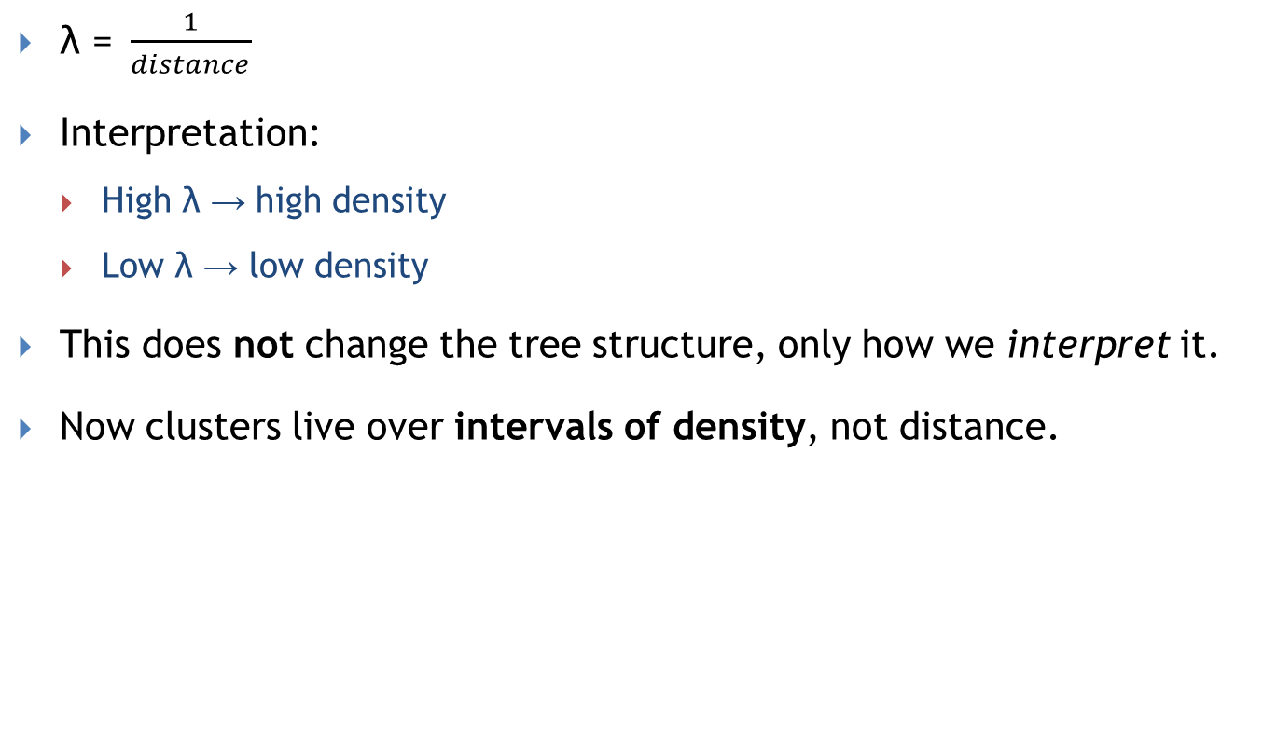
Reparameterization: From Distance to Density (λ)
$\text{λ}\text{ =} \frac{1}{distance}$
Interpretation:
  High λ → high density
  Low λ → low density
This does not change the tree structure, only how we interpret it.
Now clusters live over intervals of density, not distance.

Slide 45
Cluster birth and death
A cluster is born when:
  Its points first become connected
  At a specific λ value
A cluster dies when:
  It merges with another cluster, or
  It splits into valid subclusters
Birth and death define the lifetime of a cluster.

Slide 46
Step 5: Condensed Cluster Tree
Observation:
  Many splits separate only 1–2 points
  These are usually noise, not real clusters
Introduce the parameter minimum_cluster_size
  If a split creates a cluster smaller than this size → treat it as points falling out
  Otherwise → accept it as a real split
Result:
  A simplified hierarchy: the condensed tree

Slide 47
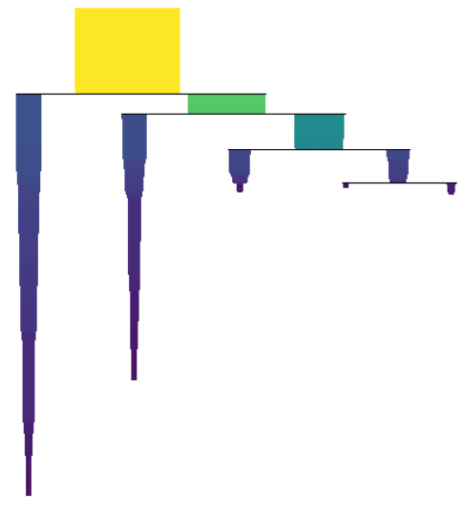
Example of condensed tree
In the condensed tree:
  Each cluster is drawn as a rectangle
  x-axis: number of points (cluster size)
  y-axis: density λ
As λ decreases:
  Points may fall out → rectangle narrows
  Cluster may split → new rectangles appear

Slide 48
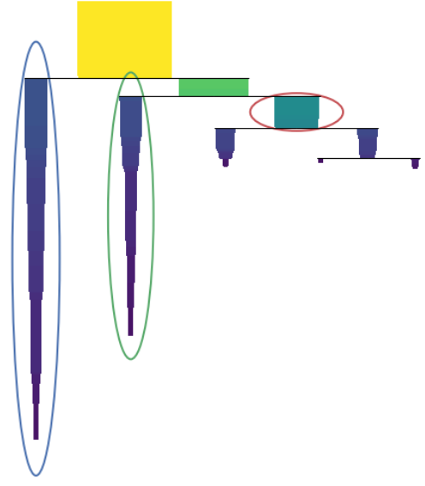
Cluster Stability
Intuition:
  A good cluster exists for a long time and contains many points.
Stability measures:
  How long a cluster persists
  Weighted by how many points stay in it
Formally:
  stability = sum over points of (λ_p − λ_birth)
    𝜆_birth: cluster birth
    𝜆_𝑝: point leaves the cluster
Geometrically:
  Stability = area of the rectangle

Slide 49
Step 6: Selecting the Final Clusters
We do not cut at a fixed λ.
Instead:
  Traverse the condensed tree bottom-up
  For each cluster:
    Compare its stability with the sum of its children’s stabilities
Rule:
  If parent is more stable → select parent
  Otherwise → select children
This ensures:
  No overlapping selections
  Preference for robust structure

Slide 50
Final Output of HDBSCAN
HDBSCAN returns:
  Cluster labels
    Points belonging to stable clusters get a label
  Noise points (label = −1)
    Points not consistently assigned become noise
  Membership strength for each point
Membership strength:
  Derived from normalized λ values
  Indicates confidence of assignment

Slide 51
Main Hyperparameters
min_cluster_size:
  minimum size of a cluster
min_samples:
  controls strictness of density requirement
Higher values → more conservative clustering

Slide 52
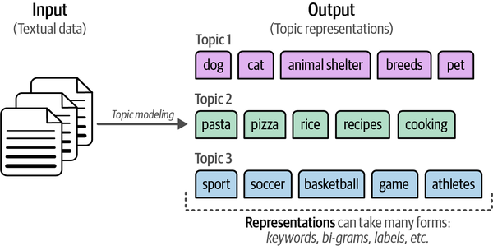
Inspecting the Clusters / Topic modeling
We can inspect each generated cluster manually and explore the assigned documents to get an understanding of its content.
This idea of finding themes or latent topics in a collection of textual data is often referred to as topic modeling.
Traditionally, it involves finding a set of keywords or phrases that best represent and capture the meaning of the topic

Slide 53
Topic Modeling
Unsupervised statistical method for discovering hidden themes in large text collections (typically in the form of keywords).
Automatically identifies topics from word patterns—no manual labeling needed.
Reveals how themes are connected and how they evolve over time.
Enables scalable organization and summarization of large text archives.
David M. Blei: Probabilistic topic models. Commun. ACM 55(4): 77-84 (2012)

Slide 54
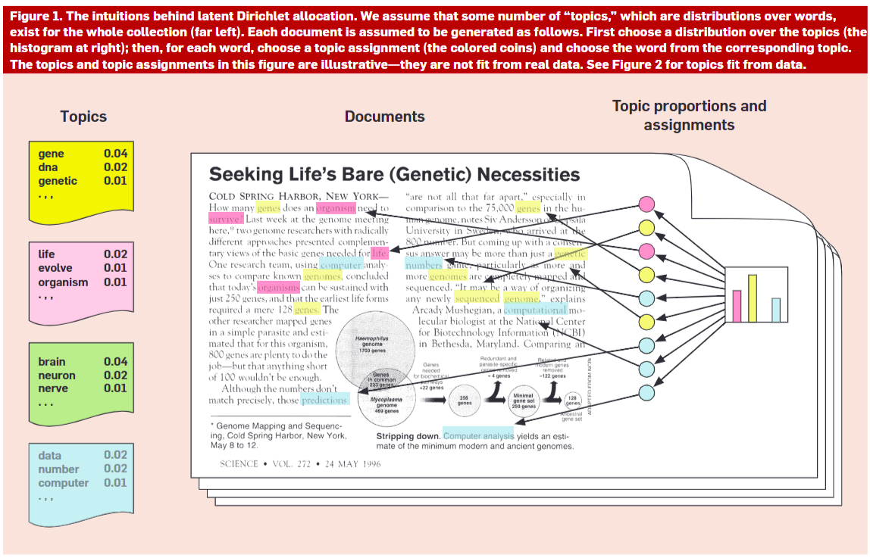
LDA for Topic Modeling

Slide 55
Topic Modeling with LDA
Goal of LDA
  Latent Dirichlet Allocation (LDA) is a statistical model used to automatically discover topics present in a collection of documents.
    Each document discusses multiple topics.
    Each topic is a distribution over words.
A topic is a probability distribution over a vocabulary.
  The topic genetics might include: DNA, gene, inheritance with high probabilities.
  The topic evolutionary biology might include: evolution, natural selection, adaptation.

Slide 56
LDA
Imagine documents are generated through a random process (a generative model).
LDA tries to reverse-engineer this hidden process.
Step 1: Generate topics
  A fixed set of topics is created for the entire document collection.
Step 2:
  For each document
    a. Sample a distribution over topics (which topics appear, and in what proportions).→ e.g., Document D1 is 70% about genetics and 30% about evolutionary biology.
    b. For each word in the document:
      Choose a topic according to the document’s topic distribution.
      Choose a word from that topic (i.e., words that are likely under that topic).

Slide 57
LDA
LDA assumes an imaginary generative process: a model that describes how the documents could have been created
For each document:
  A topic distribution is sampled → θ_{ᵈ} (the topic proportions for document d).
  For each word in the document:
    A topic z_{d,n} is sampled from θ_{ᵈ}.
    A word w_{d,n} is sampled from the selected topic’s word distribution βₖ.
Variables:
  θ_{ᵈ} = topic distribution for document d.
  z_{d,n} = topic assigned to the n-th word of document d.
  w_{d,n} = observed word.
  β_{1:K} = word distributions for the K topics (assumed fixed).

Slide 58
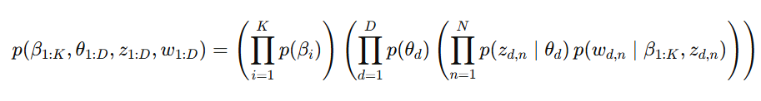
LDA formally
For each topic, a distribution over words is drawn according to 𝑝(𝛽𝑖) where 𝑝(𝛽𝑖) is the probability of the topic.
For document d: A distribution over topics is drawn: 𝑝(𝜃_{𝑑}) where 𝜃_{𝑑} is the topic proportions for the document.
For each word position n in document d:
  A topic assignment is sampled: 𝑝(𝑧_{d,𝑛}∣𝜃_{𝑑})
  A word is sampled from the selected topic’s word distribution:𝑝(w_{d,𝑛} ∣𝛽_{1:𝐾}, 𝑧_{d,𝑛})
  That is, the word is drawn from the distribution βₖ corresponding to the topic 𝑧_{d,𝑛}
This formula expresses the joint probability of:the topic-to-word distributions (β),the document-to-topic distributions (θ),the topic assignments of each word (z),and the observed words in the corpus (w),according to the assumptions of the generative model in LDA.

Slide 59
LDA formally
In practice, we only observe the words in the documents (w), while the latent variables (θ, z, β) are hidden.
The goal of inference is to recover the hidden structure:
  What are the underlying topics in the corpus?
  What is each document's mixture of topics?
  Which topic generated each word?
Technically:
  We want to compute the posterior distribution:
    P(topic structure∣documents)
That is: given the documents, what is the most likely topic structure?
But this is computationally intractable
  it requires summing over all possible configurations of the latent variables.
Approximate solutions exist to solve the problem!

Slide 60
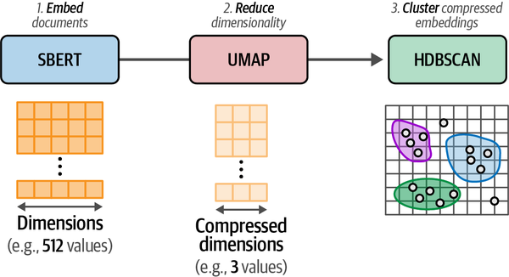
BERTopic in a nutshell
Combines:
  Transformer embeddings (semantic meaning)
  Dimensionality reduction (UMAP)
  Density-based clustering (HDBSCAN)
  Interpretable topic representations (c-TF-IDF)

Slide 61
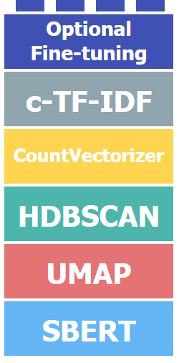
High-level pipeline
Embed documents with BERT / SBERT
Reduce dimensionality with UMAP
Cluster documents with HDBSCAN
Extract topic words with c-TF-IDF
(Optional) Refine topics with re-ranking

Slide 62
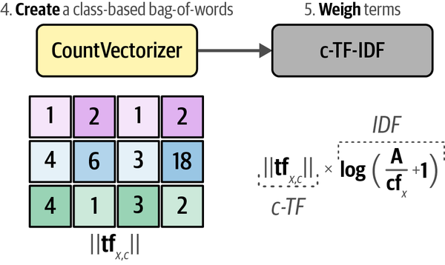
Topic Representation with c-TF-IDF
Clustering gives groups of documents
c-TF-IDF summarizes each cluster with keywords
  a class-based variant of TF-IDF to put more weight on words that are more meaningful to a cluster and less weight on words that are used across all clusters.
  tf_{x,c}​: frequency of term x in cluster c (raw count)
  cf_{x}​ : number of clusters where x appears
  A: average number of words per cluster

Slide 63
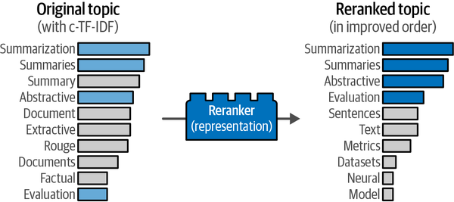
Adding a Reranker
The pipeline in BERTopic still represents a topic through a bag-of-words without taking into account semantic structures.
A reranker leverages the strength of the bag-of-words representation to generate a meaningful representation.
  We can use this first meaningful representation and tweak it using more powerful but slower techniques, like embedding models.

Slide 64
References
D. Jurafsky & J. H. Martin: Speech and Language Processing, Pearson International 3ed draft https://web.stanford.edu/~jurafsky/slp3/
D. Jurafsky, slides from NLP Courses http://web.stanford.edu/~jurafsky/
Dan Klein, Slides from NLP Course http://www.cs.berkeley.edu/~klein/cs288/sp10/slides/SP10%20cs288%20lecture%203%20--%20language%20models%20II%20(6PP).pdf
J. Leskovec, A. Rajaraman, J. Ullman: Mining of Massive Datasets Stanford University http://www.mmds.org
Landauer, T. K., Foltz, P. W., & Laham, D. (1998). Introduction to Latent Semantic Analysis. Discourse Processes, 25, 259-284.
Bing Liu: Sentiment Analysis and Opinion Mining. Synthesis Lectures on Human Language Technologies, Morgan & Claypool Publishers 2012
Jay Alammar, Maarten Grootendorst: Hands-On Large Language Models Published by O'Reilly Media, Inc.
MATERIALE DIDATTICO INTERNO DEL CORSO DI BIG DATA ANALYSIS.
La diffusione e pubblicazione on line del materiale è assolutamente proibita.

Slide 65
References
Zhijiang Guo, Michael Schlichtkrull, and Andreas Vlachos. 2022. A Survey on Automated Fact-Checking. Transactions of the Association for Computational Linguistics, 10:178–206.
MATERIALE DIDATTICO INTERNO DEL CORSO DI BIG DATA ANALYSIS.
La diffusione e pubblicazione on line del materiale è assolutamente proibita.
MATERIALE DIDATTICO INTERNO DEL CORSO DI BIG DATA ANALYSIS.
La diffusione e pubblicazione on line del materiale è assolutamente proibita.

